Slide 1
High School
Endorsement Selection
October 4th- 8th

Slide 2

There are a lot of careers out there. LCISD students have a wealth of choices for their plans after high school. The foundation high school program plus endorsement help students focus their interest, select their coursework, and better plan for their postsecondary training and education.
20XX
Notes:
Introduction to course selection

Slide 3
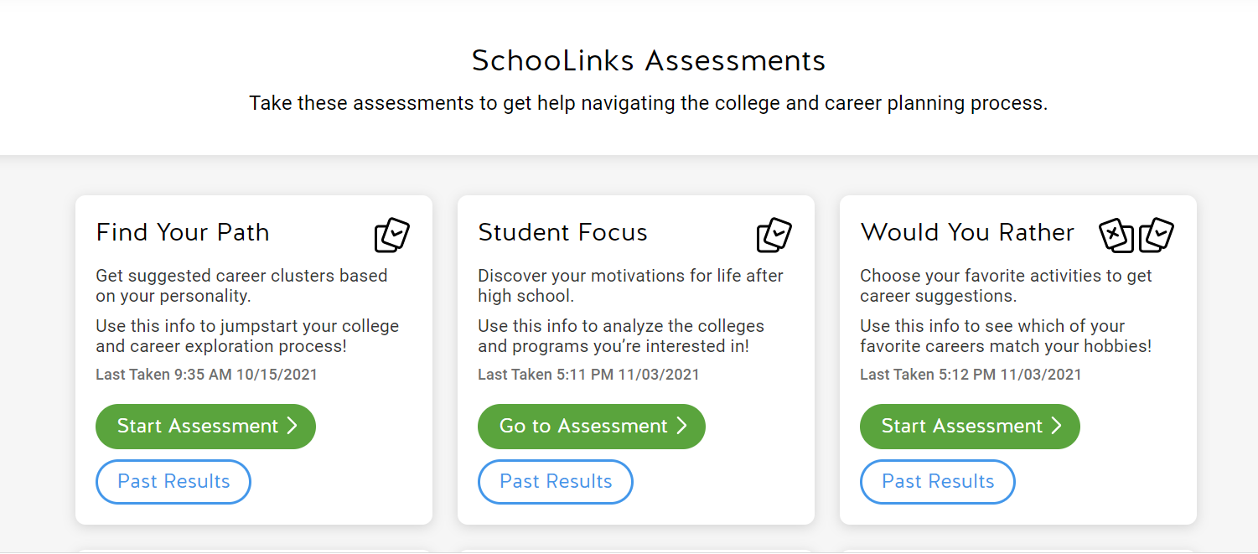
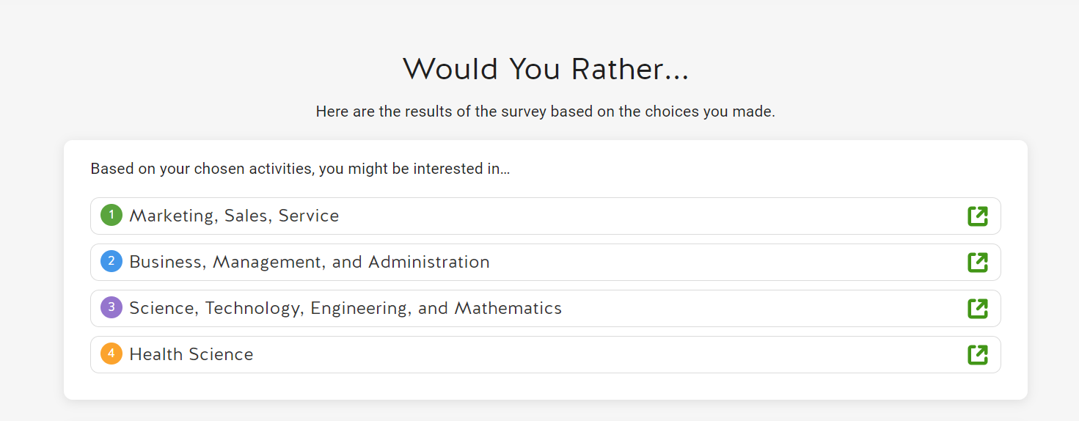
Career Exploration
Taking the assessments in Schoolinks helps students decide which PROGRAM OF STUDY to pursue in High School. The PROGRAM OF STUDY determines what Endorsement a student will choose.

Slide 4
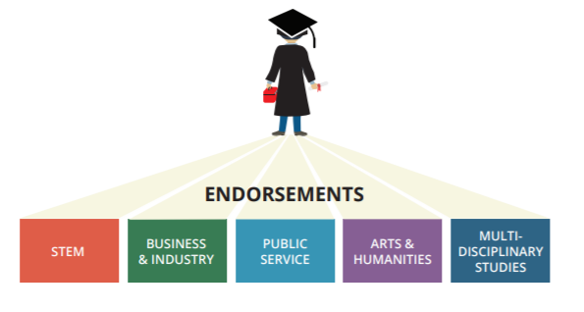
Endorsement Requirements
Students entering 9th grade must indicate their Endorsement in writing via Skyward and parents should review and sign Endorsement choice via Skyward as well.
The Endorsement is chosen once a student picks the PROGRAM OF STUDY they wish to pursue.

Slide 5
Benefits to Choosing Your Program of Study/Endorsement
Students will take courses that are most interesting to them based on the career exploration in Schoolinks and choosing a Program of Study that matches their interests
Students are encouraged to take courses that support their post-secondary/career readiness goals
By completing a Program of Study that aligns with a student's career interests there’s a seamless transition between high school and post-secondary preparation.
Notes:
Note the general benefits of selecting and Endorsement

Slide 6
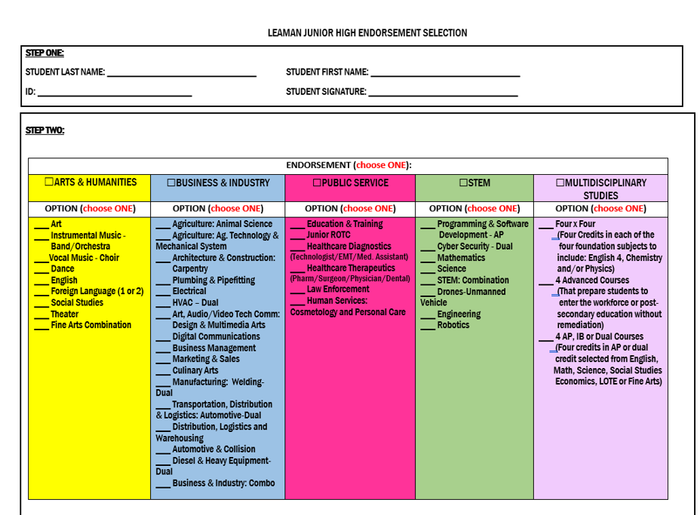
There are 5 Endorsements
The Options (Programs of Study) are more specific.

Slide 7
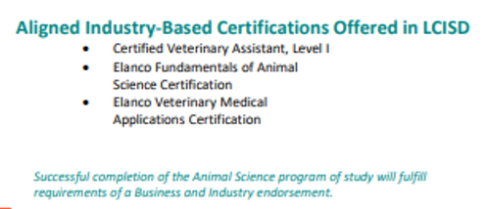
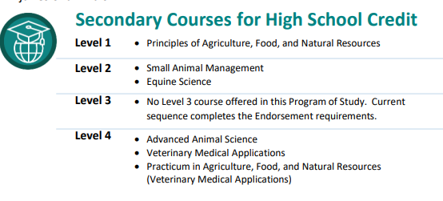
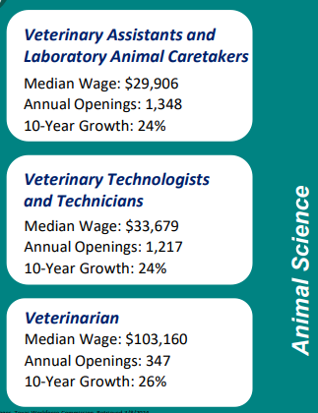
CTE Programs of Study and the 2025-2026 Course Catalog
The LCISD 2025-2026 Course Catalog highlights the CTE Programs of Study. This document gives the student an outline of the required courses, current earning potential and any certifications that are offered.
Notes:
Examples

Slide 8

What information is provided in the Course Catalog?
Program of Study
List of Courses with content
descriptions that follow
Earning Chart and Certifications Chart
Notes:
Examples

Slide 9
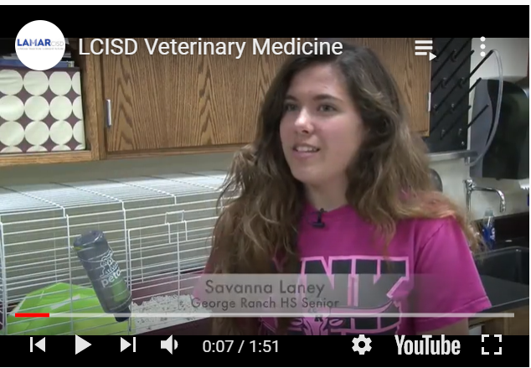


Where else can I find information on the Programs of Study
https://youtu.be/Kneqr5_lp-Y
Please visit the CTE webpage:
https://www.lcisd.org/departments/academics/cte/programs-of-study
https://youtu.be/7XI0ivH2bBw
https://youtu.be/WPXg-cgiJqM
Notes:
Examples

Slide 10
LCISD PROGRAMS OF STUDY

Slide 11
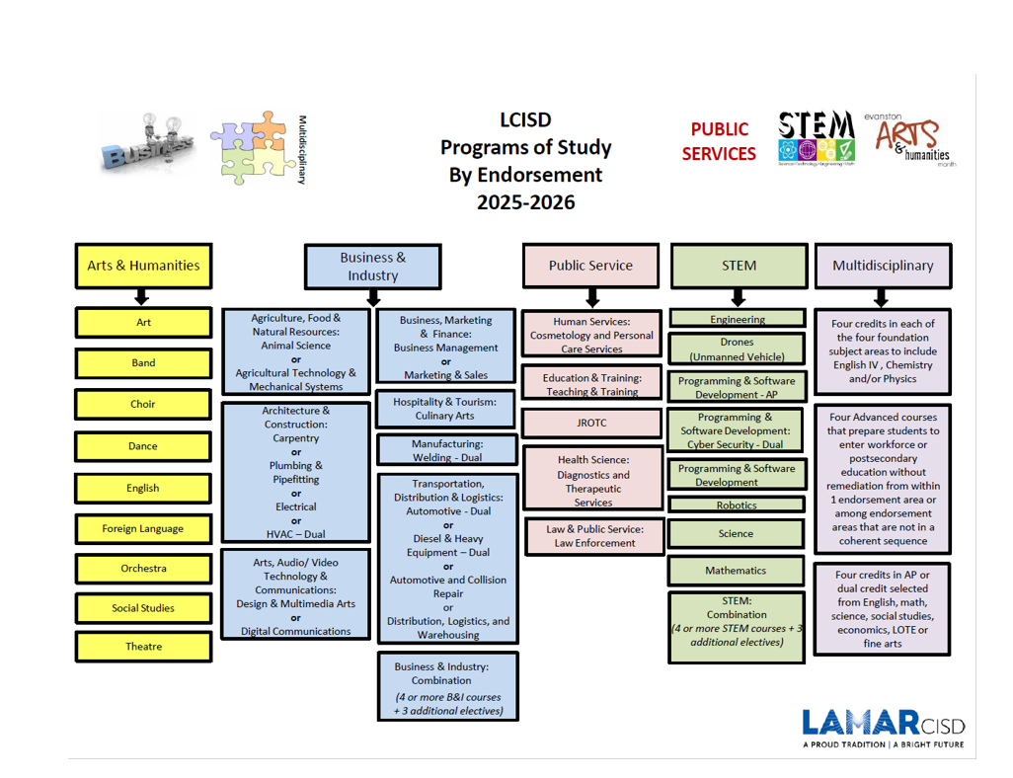

Slide 12
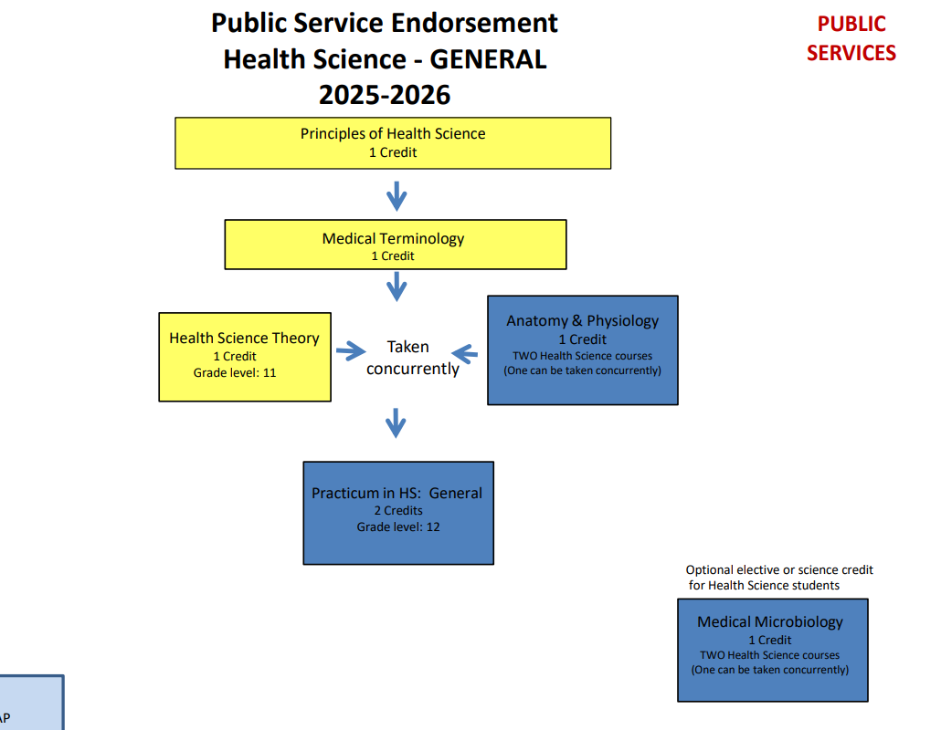
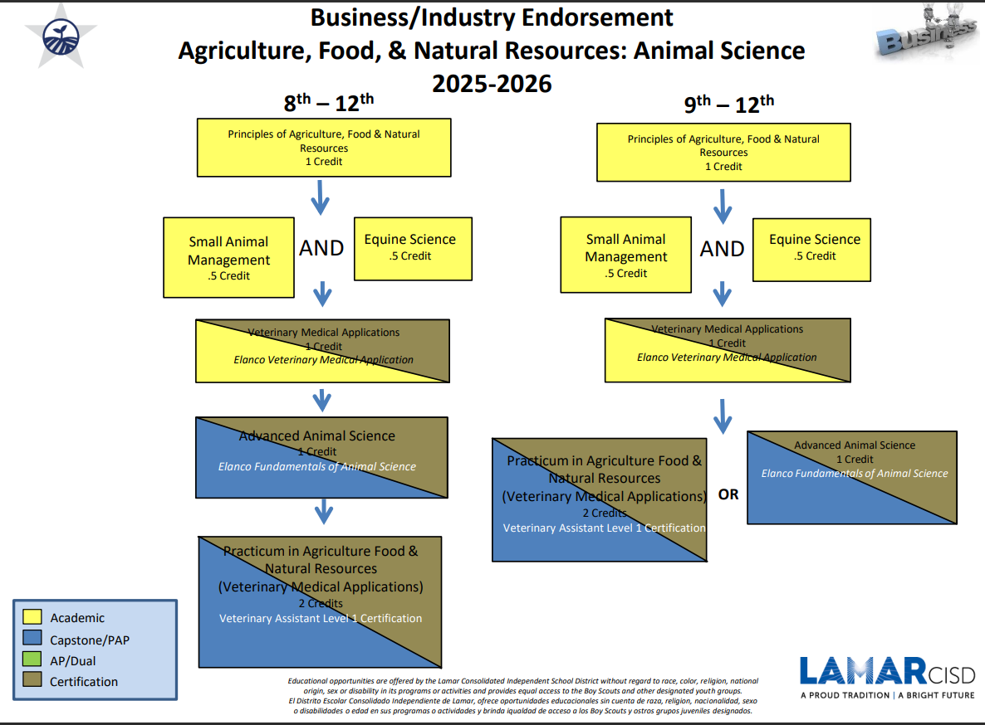
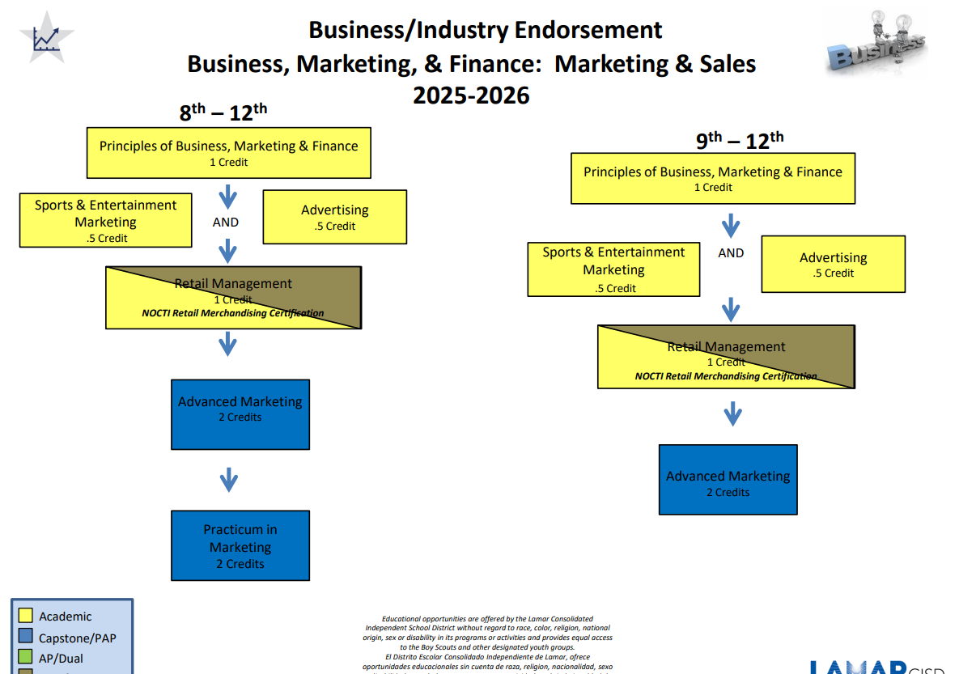
ENDORSEMENT FLOWCHARTS
The flowcharts show your electives you take each year for your chosen endorsement and program of study.
CLICK HERE

Slide 13
Multidisciplinary
A multidisciplinary endorsement in high school is a versatile option that can help students explore a variety of subjects and prepare for college or a career:
  Students take classes in a variety of subjects, including English, math, science, and social studies.
  Students can explore multiple career paths and academic options.
  Students can prepare for any college program and decide on a specialized degree plan.
  Students learn skills like critical thinking, problem solving, and active listening.
  Students can access resources to learn about labor market information and projections for specific occupations.
The multidisciplinary endorsement may be a good fit for students who:
  Have multiple interests and can't choose just one endorsement
  Are still deciding on their future
  Want to graduate with a Distinguished Level of Achievement

Slide 14
Multidisciplinary Options
Four By Four= Four credits in each of the four foundation subject areas to include English IV and Chemistry and/or Physics
Advanced Courses= Four advanced courses that prepare a student to enter the workforce successfully or postsecondary education without remediation from within one endorsement area or among endorsement areas that are not in a coherent sequence
AP or Dual Credit=Four credits in AP or dual credit selected from English, Math, Science, Social Studies, Economics, LOTE or Fine Arts

Slide 15

Selecting the Endorsement
Two steps:
#1- COMPLETE THE ENDORSEMENT SELECTION FORM
#2-INPUT ENDORSEMENT/PATHWAY OPTION IN SKYWARD

Slide 16
COMPLETING THE ENDORSEMENT SELECTION FORM

Slide 17
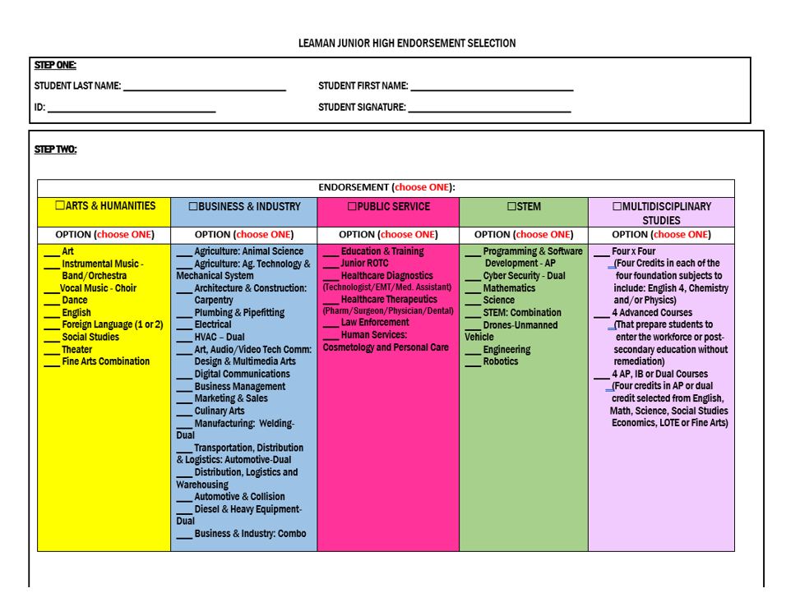



Slide 18

Step 2

Slide 19
INPUT ENDORSEMENT/PATHWAY OPTION IN SKYWARD

Slide 20
THIS VIDEO HAS STEP-BY-STEP DIRECTIONS: https://youtu.be/xvh48V7cLFI

Slide 21
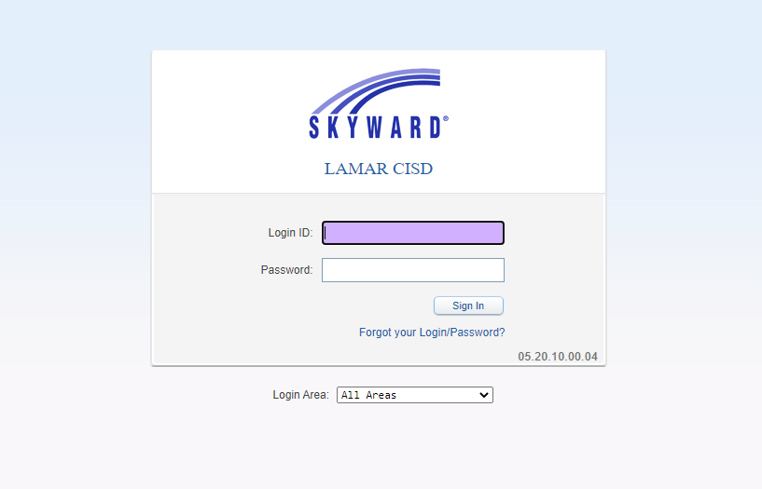

Slide 22
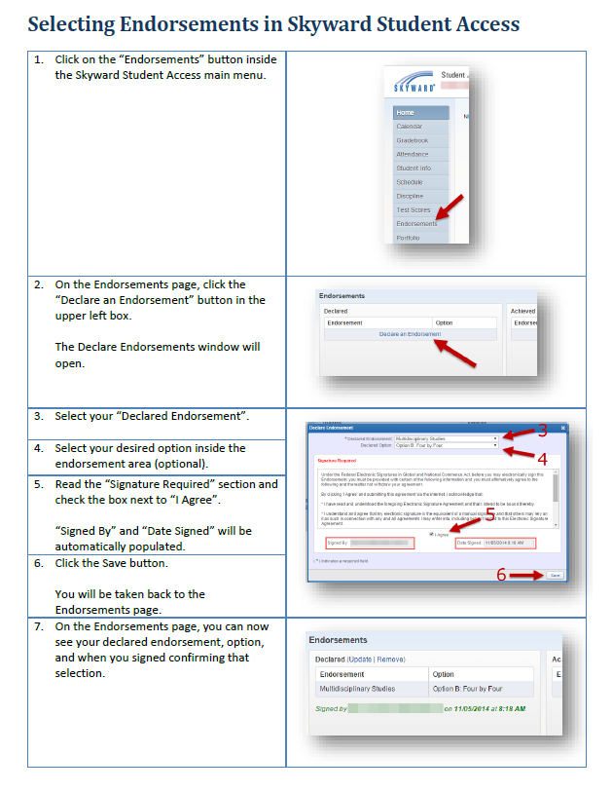

Slide 23
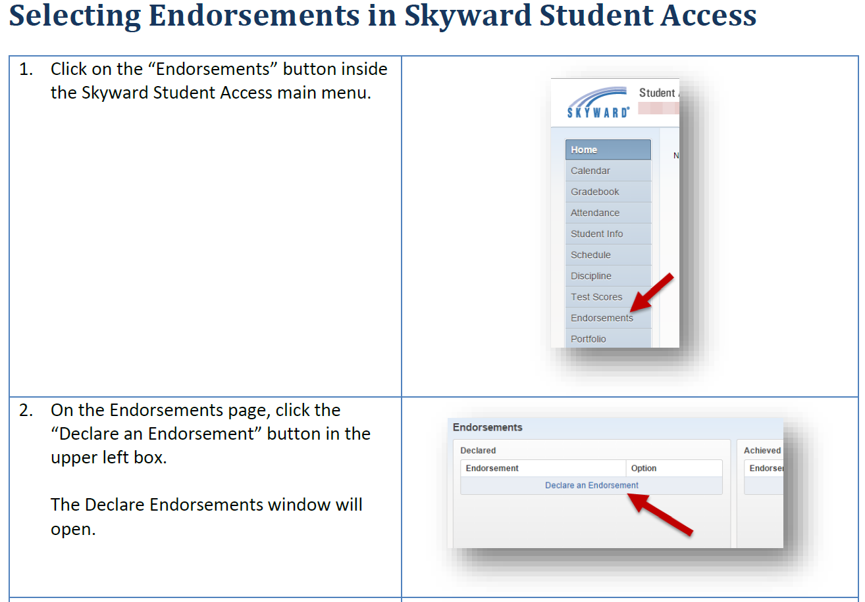

Slide 24
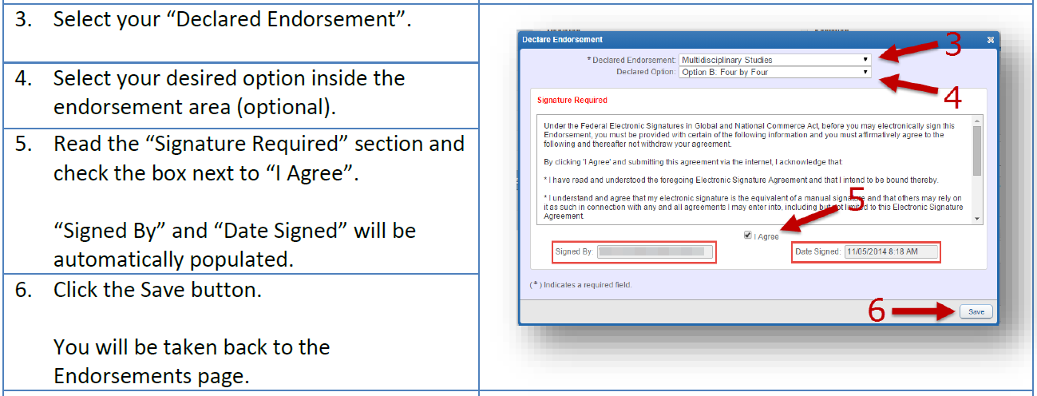

Slide 25
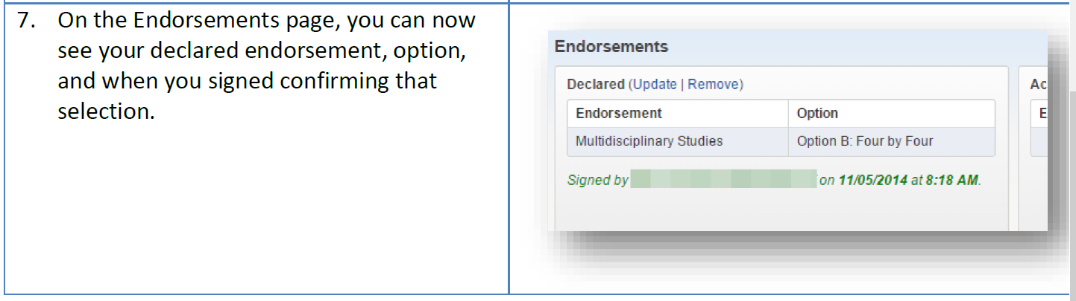

Slide 26
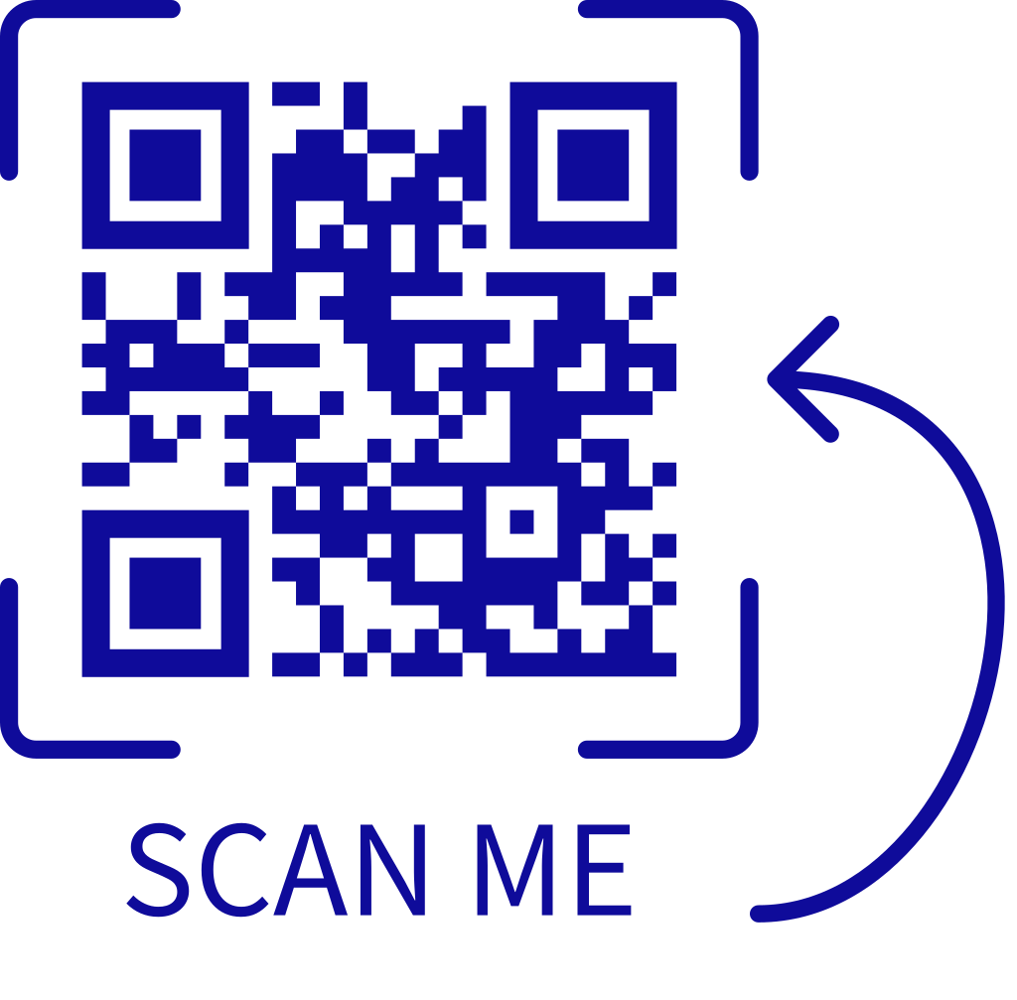
2025-2026 Course Catalog

Slide 27
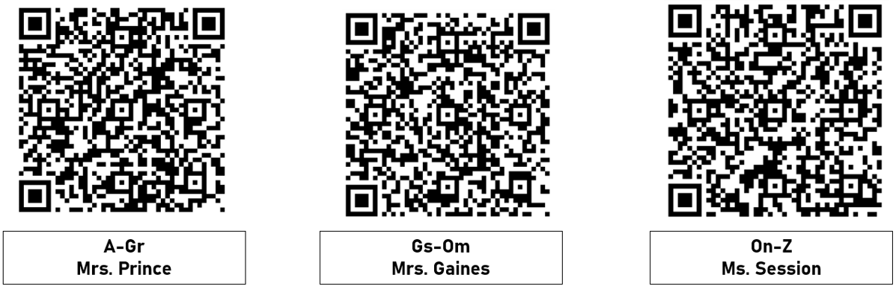
Contact your counselor if you have any QUESTIONS.

